Slide 1
Measuring Efficiency

Slide 2
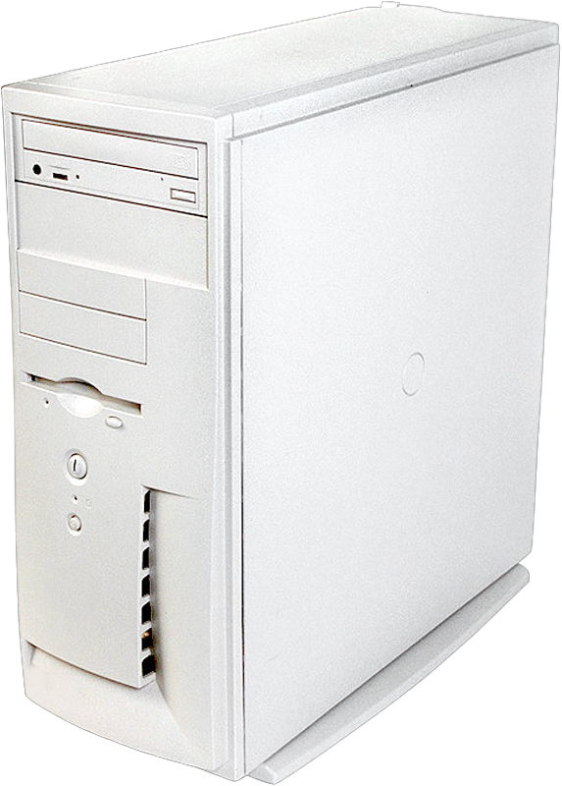

Measuring Efficiency
Even a simple program can be "inefficient".
What is an efficient algorithm?
Algorithms take time to execute
Algorithms need storage for data and variables
Complexity
Time and storage requirements of an algorithm
Analysis of algorithms
Measuring of the complexity of an algorithm
Notes:
This lecture will introduces the terminology and methods that computer scientists use to measure the efficiency of an algorithm.
Manufacturers are regularly introducing new computers that are faster and have larger memories than their recent predecessors. Yet you are always asked to write code that is efficient in its use of time, and space - which is memory. Such efficiency may not seem as pressing an issue as it was fifty years ago, when computers were much slower and their memory size was much smaller than they are now. Even so, efficiency remains an issue—in some circumstances, a critical issue. For example, when a search is performed on the Internet, millions or billions of records of information must be searched and analyzed quickly enough that it feels to the user that the response is immediate.
@@ What is an efficient algorithm? Well, algorithms have both time and space requirements - this is called the complexity of the algorithm. Measuring this complexity is called the ANALYSIS of ALGORITHMS
@@ When we assess an algorithm’s complexity, we are not measuring how involved or difficult it is. Instead, we measure an algorithm’s time complexity—the time it takes to execute—or its space complexity—the memory it needs to execute.
@@ The time and space complexities of an algorithm usually have an inverse relationship. If you try to speed up an algorithm, you will often need more storage. If you try to reduce storage, you may increase the time requirement (or slowdown) the algorithm.

Slide 3
Types of Complexity
Time complexity
Speed (number of operations)
Space complexity
Storage (memory or disk)
Inverse relationship
Faster algorithms can require more space
Reducing storage can increase execution time
Notes:
This lecture will introduces the terminology and methods that computer scientists use to measure the efficiency of an algorithm.
Manufacturers are regularly introducing new computers that are faster and have larger memories than their recent predecessors. Yet you are always asked to write code that is efficient in its use of time, and space - which is memory. Such efficiency may not seem as pressing an issue as it was fifty years ago, when computers were much slower and their memory size was much smaller than they are now. Even so, efficiency remains an issue—in some circumstances, a critical issue. For example, when a search is performed on the Internet, millions or billions of records of information must be searched and analyzed quickly enough that it feels to the user that the response is immediate.
@@ What is an efficient algorithm? Well, algorithms have both time and space requirements - this is called the complexity of the algorithm. Measuring this complexity is called the ANALYSIS of ALGORITHMS
@@ When we assess an algorithm’s complexity, we are not measuring how involved or difficult it is. Instead, we measure an algorithm’s time complexity—the time it takes to execute—or its space complexity—the memory it needs to execute.
@@ The time and space complexities of an algorithm usually have an inverse relationship. If you try to speed up an algorithm, you will often need more storage. If you try to reduce storage, you may increase the time requirement (or slowdown) the algorithm.

Slide 4
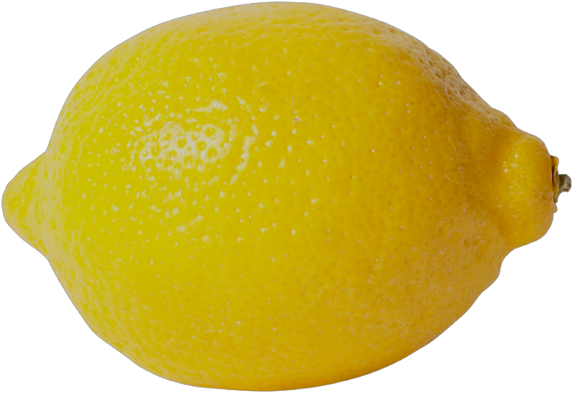

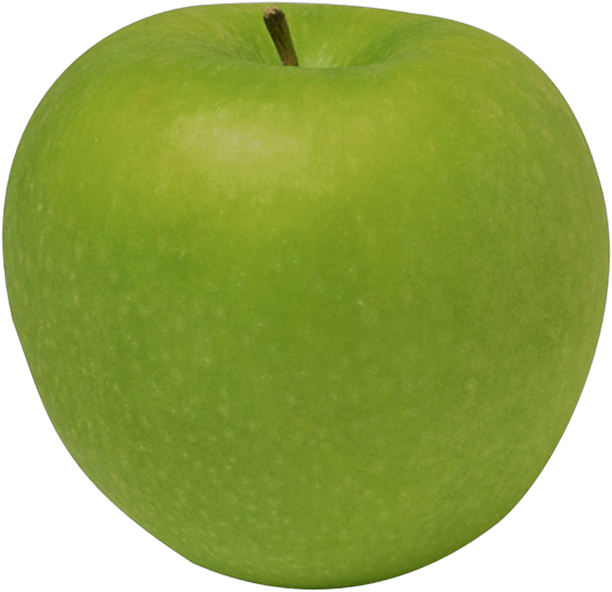

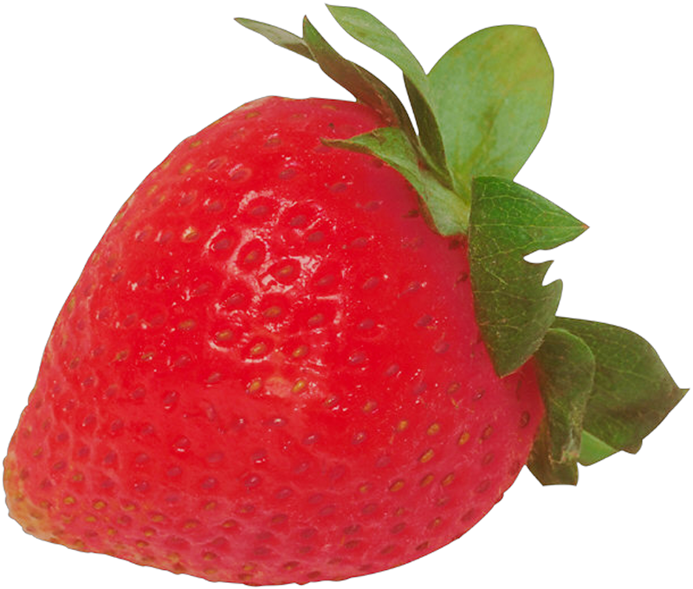
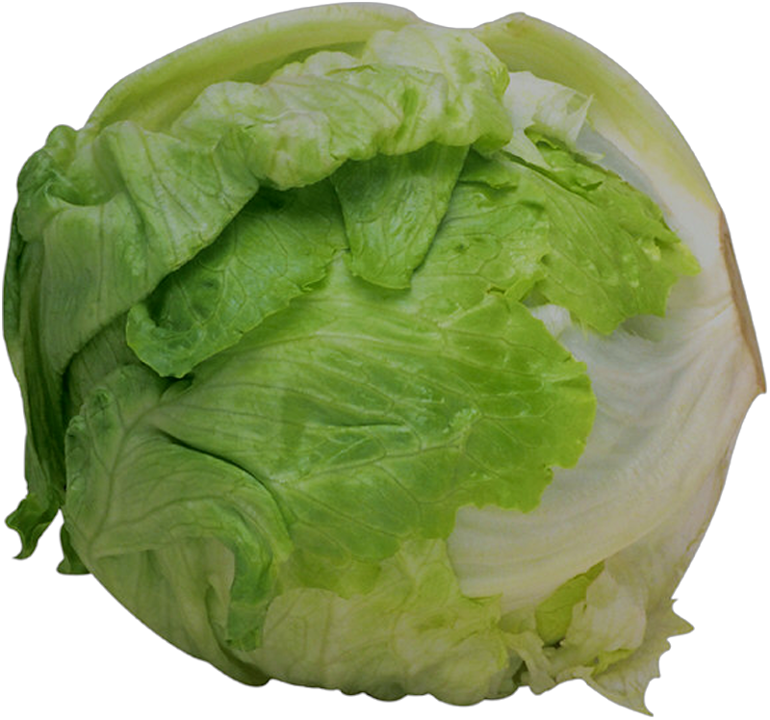
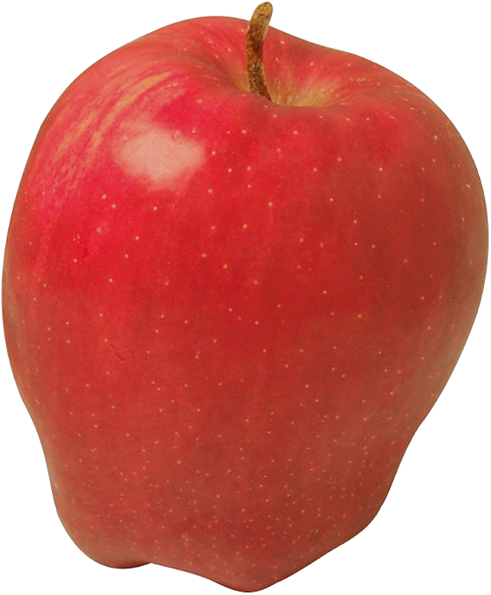

Measuring Complexity
Express complexity in problem size
Size is number of items processed by algorithm
Number of items usually represented by n
Our interest is in large problems
Small problems can take very little time even if the algorithm is inefficient
n = 7
Notes:
Our measure of the complexity of an algorithm should be easy to compute, certainly easier than implementing the algorithm. We express this measure in terms of the size of the problem. This problem size is the number of items that an algorithm processes. For example, if you are searching a collection of data, the problem size is the number of items in the collection. Such a measure enables us to compare the relative cost of algorithms as a function of the size of the problem. Typically, we are interested in large problems; a small problem is likely to take little time, even if the algorithm is inefficient.
@@ We cannot compute the actual time requirement of an algorithm. After all,we you haven't implemented the algorithm in Java nor chosen a computer to run it on. Instead, you find a function of the problem size that behaves like the algorithm’s actual time requirement. Therefore, as the time requirement increases by some factor, the value of the function increases by the same factor, and vice versa. The value of the function is said to be directly proportional to the time requirement.
Such a function is called a growth-rate function because it measures how an algorithm’s time requirement grows as the problem size grows. Because they measure time requirements, growth-rate functions have positive values. By comparing the growth-rate functions of two algorithms, you can see whether one algorithm is faster than the other for large-size problems.
@@ Using growth-rate functions for comparisons gives us a common basis for comparison that is independent of how the algorithm is coded, what computer it is run on and the data type used by the algorithm. While each of these can impact the speed and storage requirements of the final implementation, they are separate issues that are dependent on the actual implementation. Since we can assume that each of our algorithms we be applied to the same data on the same computer, these do not need to factor into our comparisons.
You may think that you are not likely to write a program in the near future whose execution time is noticeably long. You might be right, but lets look at an example where execution time may be long than expected.

Slide 5
Measuring Complexity
Do not compute actual time for an algorithm
Execution time is dependent on
Language and compiler efficiency
Computer capabilities
Compute growth-rate function
Measurement directly proportional to the algorithm’s time requirement
Gives common basis for comparison
Notes:
Our measure of the complexity of an algorithm should be easy to compute, certainly easier than implementing the algorithm. We express this measure in terms of the size of the problem. This problem size is the number of items that an algorithm processes. For example, if you are searching a collection of data, the problem size is the number of items in the collection. Such a measure enables us to compare the relative cost of algorithms as a function of the size of the problem. Typically, we are interested in large problems; a small problem is likely to take little time, even if the algorithm is inefficient.
@@ We cannot compute the actual time requirement of an algorithm. After all,we you haven't implemented the algorithm in Java nor chosen a computer to run it on. Instead, you find a function of the problem size that behaves like the algorithm’s actual time requirement. Therefore, as the time requirement increases by some factor, the value of the function increases by the same factor, and vice versa. The value of the function is said to be directly proportional to the time requirement.
Such a function is called a growth-rate function because it measures how an algorithm’s time requirement grows as the problem size grows. Because they measure time requirements, growth-rate functions have positive values. By comparing the growth-rate functions of two algorithms, you can see whether one algorithm is faster than the other for large-size problems.
@@ Using growth-rate functions for comparisons gives us a common basis for comparison that is independent of how the algorithm is coded, what computer it is run on and the data type used by the algorithm. While each of these can impact the speed and storage requirements of the final implementation, they are separate issues that are dependent on the actual implementation. Since we can assume that each of our algorithms we be applied to the same data on the same computer, these do not need to factor into our comparisons.
You may think that you are not likely to write a program in the near future whose execution time is noticeably long. You might be right, but lets look at an example where execution time may be long than expected.

Slide 6
Measuring Complexity
Comparing algorithms should be independent of
Specific Implementations
how are the algorithms coded
Computer
what computer is used
Data
the data the program uses
Notes:
Our measure of the complexity of an algorithm should be easy to compute, certainly easier than implementing the algorithm. We express this measure in terms of the size of the problem. This problem size is the number of items that an algorithm processes. For example, if you are searching a collection of data, the problem size is the number of items in the collection. Such a measure enables us to compare the relative cost of algorithms as a function of the size of the problem. Typically, we are interested in large problems; a small problem is likely to take little time, even if the algorithm is inefficient.
@@ We cannot compute the actual time requirement of an algorithm. After all,we you haven't implemented the algorithm in Java nor chosen a computer to run it on. Instead, you find a function of the problem size that behaves like the algorithm’s actual time requirement. Therefore, as the time requirement increases by some factor, the value of the function increases by the same factor, and vice versa. The value of the function is said to be directly proportional to the time requirement.
Such a function is called a growth-rate function because it measures how an algorithm’s time requirement grows as the problem size grows. Because they measure time requirements, growth-rate functions have positive values. By comparing the growth-rate functions of two algorithms, you can see whether one algorithm is faster than the other for large-size problems.
@@ Using growth-rate functions for comparisons gives us a common basis for comparison that is independent of how the algorithm is coded, what computer it is run on and the data type used by the algorithm. While each of these can impact the speed and storage requirements of the final implementation, they are separate issues that are dependent on the actual implementation. Since we can assume that each of our algorithms we be applied to the same data on the same computer, these do not need to factor into our comparisons.
You may think that you are not likely to write a program in the near future whose execution time is noticeably long. You might be right, but lets look at an example where execution time may be long than expected.

Slide 7
Growth-Rate Functions

Slide 8
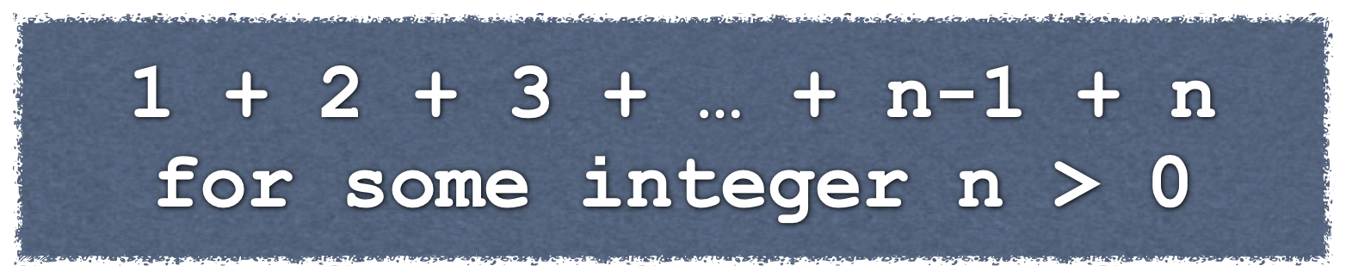
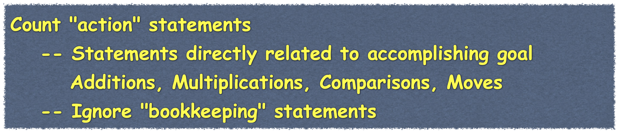


Growth-Rate Functions
Find the sum of the first n positive integers:
Finding the growth-rate function
Count basic operations
Algorithm A | Algorithm B | Algorithm C
sum = 0 for i = 1 to n sum = sum + i | sum = 0 for i = 1 to n for j = 1 to i sum = sum + 1 | sum = n*(n + 1)/2
Additions | n | n (n + 1) / 2 | 1
Multiplications |  |  | 1
Divisions |  |  | 1
Total Operations | n | (n² + n)/2 | 3
Notes:
Consider the problem of computing the sum 1 + 2 + . . . + n for any positive integer n.
@@ The first algorithm that may come to mind could be a simple loop that accumulates a sum from 1 up to the number N
@@ Algorithm B performs a simpler task - it repeatedly adds 1 to the sum. Then it adds 1 twice to the sum. Then 1 is added three times. This continuers until 1 is added to sum n-time in the inner loop.
@@ Finally, Algorithm C uses an algebraic identity to compute the sum
If you execute this code with n equal to ten thousand (10,000), we get the right answer of 50,005,000 for each of the algorithms. Now change the value of n to one hundred thousand (100,000), and execute the code again. Once more, we get the correct answer, which this time is 5,000,050,000.
However, you should notice a delay in seeing the result for Algorithm B. Now try one million (1,000,000) for the value of n. Again you will get the correct answer—500,000,500,000—but you will have to wait even longer for the result from Algorithm B. The wait might be long enough for you to suspect that something is broken. If not, you can try a larger value of n.
The simple code for Algorithm B takes a noticeably long time to execute, much longer than either of the other two algorithms. If it were the only algorithm you tried, what should you do? Use a faster computer? While that might be a solution, it’s clear that we should use a different algorithm.
@@ So how can we tell which algorithm is slowest and which is fastest? The integer n is a measure of the problem size: As n increases, the sum involves more terms. To measure the effort, or time requirement, of an algorithm, we must find an appropriate growth-rate function. To do so, we might begin by counting the number of basic operations required by the algorithm.
@@ An algorithm’s basic operation is the most significant contributor to its total time requirement. These statements are highlighted in yellow in the algorithm.
For example, Algorithms A and B have addition as their basic operation. An algorithm that sees whether an array contains a particular object has comparison as its basic operation. The most frequent operation is not necessarily the basic operation. For example, assignments are often the most frequent operation in an algorithm, but they rarely are basic. Loop control statements, such as for or while loops, are often not basic operations either.
Ignoring operations that are not basic, such as bookkeeping operations like the initialization of variables, the operations that control loops, and so on, will not affect our final conclusion about algorithm speed.
@@ For example, Algorithm A requires n additions of i to sum in the body of the loop. We can conclude that Algorithm A requires time that increases linearly with n, even though we ignored operations that are not basic to the algorithm. Thus, Algorithm A’s growth-rate function is n.
@@ Now let’s count the number of basic operations required by Algorithms B and C. The basic operation for Algorithm B is addition;
@@ for Algorithm C, the basic operations are addition, multiplication, and division. Remember, these counts do not include assignments and the operations that control the loops.

Slide 9
Growth-Rate Functions
Number of operations required as a function of n
3
n
(n²+n)/2
Notes:
If we plot the growth function for each of algorithms we see that Algorithm C is flat, or constant. No matter how large n grows, Algorithm C always takes only 3 basic operations so Algorithm C is independent of n
@@ Algorithm A grows gradually with n, this is linear growth we say that Algorithm A requires time proportional to n.
@@ Algorithm B grows very quickly, with only 10 items to add together, it already requires more than five times the number of operations needed by Algorithm A.
Typical growth-rate functions are algebraically simple. Since we are not likely to notice the effect of an inefficient algorithm when the problem is small, we should focus on large problems.
@@ Thus, if we care only about large values of n when comparing the algorithms, we can consider only the dominant term in each growth-rate function.
@@ For example, for Algorithm B we can say (n² + n) / 2 behaves like n² when n is large.
@@ First, n2 is much larger than n for large values of n,
@@ so (n2 + n) / 2 behaves like n2 / 2.
@@ Also, n2 / 2 behaves like n2 when n is large. In other words, for large n, the difference between the value of (n2 + n) / 2 and that of n2 is relatively small and can be ignored.
So instead of using (n2 + n) / 2 as Algorithm B’s growth-rate function, we can use n2—the term with the largest exponent—and say that Algorithm B requires time proportional to n². We conclude that Algorithm C is the fastest and Algorithm B is the slowest.

Slide 10


Growth-Rate Functions
Number of operations required as a function of n
3
n
(n²+n)/2
(n²+n)/2
For very large n:
n² is much larger than n
so (n² + n)/2 behaves like n²/2
and n²/2 behaves like n²
so n²/2 behaves like n²
Notes:
If we plot the growth function for each of algorithms we see that Algorithm C is flat, or constant. No matter how large n grows, Algorithm C always takes only 3 basic operations so Algorithm C is independent of n
@@ Algorithm A grows gradually with n, this is linear growth we say that Algorithm A requires time proportional to n.
@@ Algorithm B grows very quickly, with only 10 items to add together, it already requires more than five times the number of operations needed by Algorithm A.
Typical growth-rate functions are algebraically simple. Since we are not likely to notice the effect of an inefficient algorithm when the problem is small, we should focus on large problems.
@@ Thus, if we care only about large values of n when comparing the algorithms, we can consider only the dominant term in each growth-rate function.
@@ For example, for Algorithm B we can say (n² + n) / 2 behaves like n² when n is large.
@@ First, n2 is much larger than n for large values of n,
@@ so (n2 + n) / 2 behaves like n2 / 2.
@@ Also, n2 / 2 behaves like n2 when n is large. In other words, for large n, the difference between the value of (n2 + n) / 2 and that of n2 is relatively small and can be ignored.
So instead of using (n2 + n) / 2 as Algorithm B’s growth-rate function, we can use n2—the term with the largest exponent—and say that Algorithm B requires time proportional to n². We conclude that Algorithm C is the fastest and Algorithm B is the slowest.

Slide 11
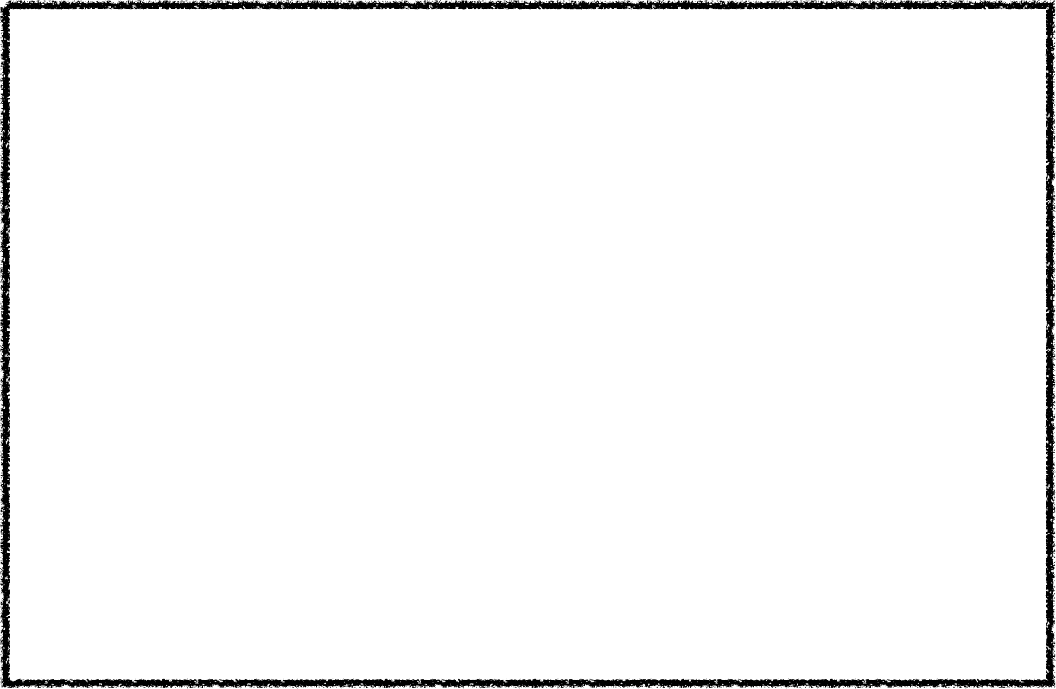
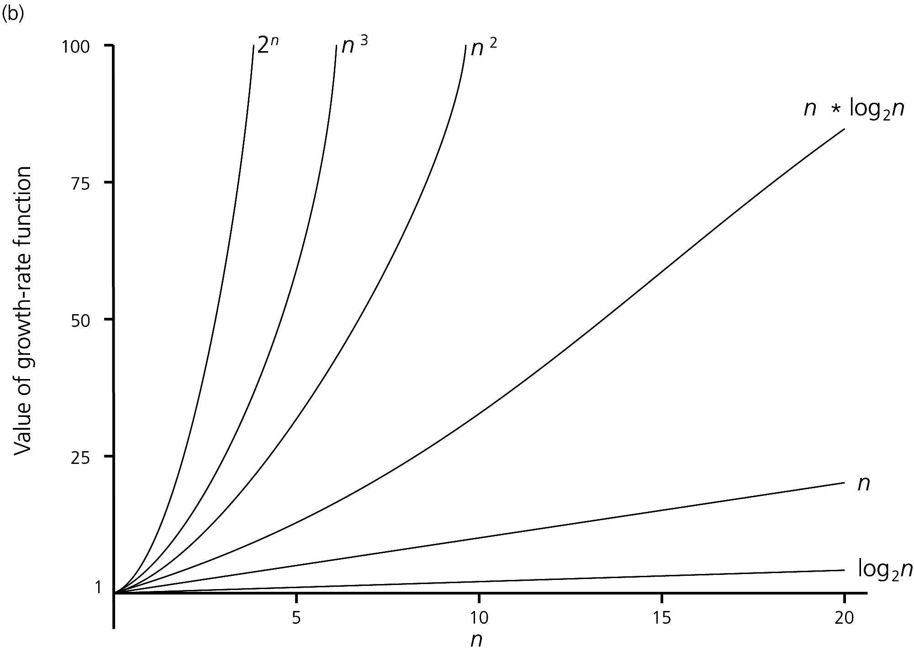



Growth-Rate Functions
Number of operations required as a function of n
n | log(log n) | log n | log² n | n | n log n | n² | n³ | 2^{n} | n!
10 | 2 | 3 | 11 | 10 | 33 | 10² | 10³ | 10³ | 10⁵
100 | 3 | 7 | 44 | 100 | 664 | 10⁴ | 10⁶ | 10³⁰ | 10⁹⁴
1,000 | 3 | 10 | 99 | 1,000 | 9,966 | 10⁶ | 10⁹ | 10³⁰¹ | 10¹⁴³⁵
10⁴ | 4 | 13 | 177 | 10,000 | 132,877 | 10⁸ | 10¹² | 10³⁰¹⁰ | 10^{19,335}
10⁵ | 4 | 17 | 276 | 100,000 | 1,600,964 | 10¹⁰ | 10¹⁵ | 10^{30,103} | 10^{243,338}
10⁶ | 4 | 20 | 397 | 1,000,000 | 19,931,569 | 10¹² | 10¹⁸ | 10^{301,030} | 10^{2,9332369}
1 < log2n < n < n * log2n < n² < n³ < 2^{n} < n!
Notes:
The table shows how growth-rate functions that you are likely to encounter can grow in magnitude as n increases.
From this data we can see that algorithms whose growth-rate functions are log(log n), log n, or log2 n take much less time than algorithms whose growth-rate function is n. Although the value of n log n is significantly larger than n, either of those functions describes a growth rate that is much faster than n2
This table also shows that when analyzing the time efficiency of an algorithm, we should consider large problems. For small problems, such as for when n is less than 100, the difference between the execution times of two solutions to the same problem is usually insignificant, unless one of the solutions has a growth-rate function of 2^{n} or n!. Algorithms with those growth rates should always be avoided.
@@ Here is a graph that show the same information. it is easy to see visually how rapidly algorithms with a growth rate of 2n can increase in time.

Slide 12

Representing Algorithm Complexity
Big O notation
Order of at most n
Algorithm A | Algorithm B | Algorithm C
sum = 0 for i = 1 to n sum = sum + i | sum = 0 for i = 1 to n for j = 1 to i sum = sum + 1 | sum = n*(n + 1)/2
Total Operations | n | (n² + n)/2 | 3
Big O (Order of Magnitude) | O(n) | O(n²) | O(1)
Notes:
Computer scientists use a notation to represent an algorithm’s complexity. For example, consider the algorithms A, B, and C and the number of basic operations that each requires, as shown here.
Instead of saying that Algorithm A has a time requirement proportional to n, we say that A is O(n). We call this notation Big Oh since it uses the capital letter O. We read O(n) as either “Big Oh of n” or “order of at most n.” Similarly, since Algorithm B has a time requirement proportional to n², we say that B is Order of at most (n²). Algorithm C always requires three basic operations. Regardless of the problem size n, this algorithm requires the same time. We say that Algorithm C is Order of at mos(1).

Slide 13
Representing Algorithm Complexity
Effect of doubling the problem size on an algorithm's time requirement
Growth-Rate Function for Size n Problems | Growth-Rate Function for Size 2n Problems | Effect on Time Requirement
1 | 1 | None
log n | 1 + log n | Negligible
n | 2n | Doubles
n log n | 2n log n + 2n | Doubles then add 2n
n² | (2n)² | Quadruples
n³ | (2n)³ | Multiplies by 8
2^{n} | 2^{2n} | Squares
Notes:
let's look at what happens if we double the number of items to process for each of the various growth rates. If the growth rate is one - there is no effect
If the growth rate is log n - doubling the number of items results a negligible effect - only one more unit of time
@@ IF the function is of order at most n, then the time required will double.
@@ From there, we can see that the time requirement begins to increase greatly when the number of items is doubled. Double the number of items, even for small problems, results in squaring the time requirement for problems of order at most 2^{N}

Slide 14

Representing Algorithm Complexity
Time to process one million items at a rate of one million operations per second.
Growth-Rate Function for Size n Problems | Time to process one million items at a rate of one million operation per second
log n | 0.0000199 seconds
n | 1 second
n log n | 19.9 seconds
n² | 11.6 days
n³ | 31,709.8 years
2^{n} | 10^{301,016} years
Notes:
Now suppose that your computer can perform one million operations per second. How long will it take an algorithm to solve a problem whose size is one million?
We cannot answer this question exactly without knowing the algorithm, but the computations here can give you a sense of how the algorithm’s Big Oh would affect our answer. An Order of at most (log n) algorithm would take a fraction of a second, whereas an Order of at most (2n) algorithm would take many trillions of years!
Note that these computations estimate the time requirement of the growth-rate of various algorithms. Although this approximation is not universally valid, for many algorithms it is reasonable.
We can use algorithms of big o(n^2), O(n3), or even O(2^n) as long as the problem size is small.
For example, at the rate of one million operations per second, an Order of at most(n^2) algorithm would take one second to solve a problem whose size is 1000.
An algorithm of big O(n^3) algorithm would take one second to solve a problem whose size is 100.
And an O(2^n) algorithm would take about one second to solve a problem whose size is only 20.

Slide 15
Understanding Big O Notation

Slide 16

Picturing Efficiency
An O(n) algorithm
for i = 1 to n
sum = sum + i
...
1
2
3
4
n-1
n
1 + 1+ 1 + 1 + ... + 1 + 1 ≈ O(n)
An O(1) algorithm
for i = 1 to 1000
sum = sum + n
...
1
2
3
4
999
1000
1000 ≈ O(1)
Notes:
To picture some of these growth-functions, let's look at the number of operations for some simple loops.
Here we have Algorithm A from earlier that adds i to sum n times.
@@ If each watch represents an addition, we will see a single addition each time though the loop. We perform the loop n times, so there will be n additions and we have an algorithm of order at most n
@@ Here is another similar algorithm, but it is of order at most 1. We still have a loop and we still have n, but why does this have a bog o of only 1?
@@ The key is that the loop is ALWAYS executed the same number of times, not matter what the value of n. We always add n to sum 1000 times.
@@ If n is one million, we still only add n to sum 1000. If n is 3, we still add n or 3 to sum 1000 times. So even though this algorithm uses n, the time requirement for this algorithm is independent of n

Slide 17
Picturing Efficiency
An O(n²) algorithm
for i = 1 to n
for j = 1 to n
sum = sum + 1
...
i = 1
1
2
3
4
n-1
n
...
i = 2
1
2
3
4
n-1
n
...
...
...
...
...
...
...
...
i = n
1
2
3
4
n-1
n
n + n+ n + n + ... + n = n * n ≈ O(n²)
Notes:
Here we have an algorithm of bog Oh n^2. When we are examining nested loops, we can examine the inner loop first.
@@ We can see that we have a loop similar to the earlier one that iterates n times.
@@ So we can represent this as we did earlier.
@@ The operation performed by the inner loop is repeated n times and so we can draw the same row of watches a total of n-1 times more.
We end up with a grid that is n operations across and has n rows. This gives use n * n operations or a big oh of n^2 for this algorithm

Slide 18
Picturing Efficiency
Another O(n²) algorithm
for i = 1 to n
for j = 1 to i
sum = sum + 1
i = 1
i = 2
1 + 2+ 3 + 4 + ... + n ≈ O(n²)
i = 3
...
...
...
i = n
...
1
2
3
4
n-1
n
Notes:
Here is another algorithm that has the same growth-function.
@@ Here, the body of the inner loop requires a constant amount of execution time, each time that it executes, and so it is O(1).
If we again represent time with a watch, a row of i watches represents the time requirement for the inner loop. Here are the first two times it executes.
@@ Since the inner loop is the body of the outer loop, it executes n times.
As we computed earlier, the sum 1 + 2 + 3 + 4 and so on up to n is order at most n^2
So here we have nested loops where the outer loop is clearly dependent on n, and the inner loop is dependent on i -
@@ BUT if we look closely at this algorithm, we see that the value of i varies from 1 to n and so i is dependent on n, making both loops dependent on n.

Slide 19
Comparing Implementations
Choosing an implementation
Look for significant differences in efficiency
Frequency of operations
consider how frequently particular ADT operations occur in a given application
sometimes seldom-used but critical operations must be efficient
Best-case analysis
Determine minimum amount of time an algorithm requires to solve problems of size n
Worst-case analysis
Determine maximum amount of time an algorithm requires to solve problems of size n
Average-case analysis
Determine average amount of time an algorithm requires to solve problems of size n
Notes:
When comparing implementations of an ADT, we want to consider significant differences in efficiency, such as the difference between Big Oh of n versus n squared. Or between Big Oh of 1 and big OH of n. The specific number of operations is not as important as the concept of an algorithm being of order at most some function.
@@ We also need to consider the frequency of the various operations in the application that will use the ADT. Then, Depending on the application, we may choose a different implementation.
For example, Implementation A may have an *add* implementation the is significantly more efficient than Implementation B's add. But the "contains" method of implementation B is significantly more efficient than A's. We may decide to use Implementation B if our application is going to be searching the ADT frequently and we may decide to use Implementation A if our application will add items to the collection, but does not search or remove specific items very often.
@@ For some algorithms that operate on a data set, the execution time depends only on the size of the data set. For example, the time needed to find the smallest integer in an array of integers depends only on the number of integers, not on the integers themselves. Finding the smallest of 100 integers takes the same amount of time regardless of the values of the integers.
Other algorithms, however, have time requirements that depend not only on the size of the data set, but also on the data itself. For example, imagine that an array contains a certain value, and we want to know where in the array it occurs. Suppose our search algorithm examines each value in the array until it finds the desired one. If the algorithm finds this desired value in the first array element it examines, it makes only one comparison. In this best case, the algorithm takes the least time. The algorithm can do no better than its best-case time. If the best-case time is still too slow, you need another algorithm.
@@ Now suppose that the algorithm locates the desired value after comparing it to every value in the array. This would be the algorithm’s worst case, since it requires the most time. If you can tolerate this worst-case time, your algorithm is acceptable.
@@ For many algorithms, the worst and best cases rarely occur. Thus, we consider an algorithm’s average case, when it processes a typical data set. The average-case time requirement of an algorithm is more useful, but harder to estimate. Note that the average-case time is not the average of the best-case and worst-case times.
Some algorithms, however, do not have a best, worst, and average case. Their time requirements depend only on the number of data items given them, not on the values of that data

Slide 20

ADT Bag Interface
template<class ItemType>
class BagInterface
{
public:
virtual int getCurrentSize() const = 0;
virtual bool isEmpty() const = 0;
virtual bool add(const ItemType& newEntry) = 0;
virtual bool remove(const ItemType& target) = 0;
virtual void clear() = 0;
virtual int getFrequencyOf(const
ItemType& target) const = 0;
virtual bool contains(const
ItemType& anEntry) const = 0;
virtual std::vector<ItemType> toVector() const = 0;
virtual ~BagInterface() { }
}; // end BagInterface
template<class ItemType>
class ArrayBag : public BagInterface<ItemType>
{
private:
static const int DEFAULT_CAPACITY = 50;
ItemType items[DEFAULT_CAPACITY]; // Array of bag items
int itemCount; // Current count of bag items
O(1)
template<class ItemType>
class LinkedBag : public BagInterface<ItemType>
{
private:
Node<ItemType>* headPtr; // pointer to first node
int itemCount; // current count of bag items
Notes:
As we examine our two implementations we can begin with the methods in our ADT Bag that check the status of the collection. In both our ArrayBag implementation and our LinkedBag implementation, we can determine the currentSize of the bag and whether or not it is empty or full by performing a comparison to numberOfEntries.
@@ Each of these methods only requires that a single comparison be performed no matter how many items are in the bag. Since these methods always take the same amount of time to execute, they are at most order 1.

Slide 21
ADT Bag Add Implementations
ArrayBag
LinkedBag
template<class ItemType>
bool ArrayBag<ItemType>::add(const ItemType& newEntry)
{
bool hasRoomToAdd = (itemCount < maxItems);
if (hasRoomToAdd)
{
items[itemCount] = newEntry;
itemCount++;
} // end if
return hasRoomToAdd;
} // end add
template<class ItemType>
bool LinkedBag<ItemType>::add(const ItemType& newEntry)
{
Node<ItemType>* nextNodePtr = new Node<ItemType>();
nextNodePtr->setItem(newEntry);
nextNodePtr->setNext(headPtr);
headPtr = nextNodePtr;
itemCount++;
return true;
} // end add
O(1)
O(1)
Notes:
As we examine the ArrayBag add implementation, we see that each step in this method—
@@ detecting whether the bag is full, assigning a new entry to an array element, and incrementing the length—is an O(1) operation.
@@ It follows then that this method is O(1). Intuitively, since the method adds the new entry right after the last entry in the array, we know the index of the array element that will contain the new entry. Thus, we can make this assignment independently of any other entries in the bag.
@@ Similarly, for the LinkedBag add method implementation, All of the statements in this method represent O(1) operations, and so the method is O(1).

Slide 22



ADT Bag contains Implementations
ArrayBag
LinkedBag
template<class ItemType>
bool ArrayBag<ItemType>::contains(const
ItemType& anEntry) const
{
bool found = false;
int searchIndex = 0;
while (!found && (searchIndex < itemCount))
{
found = (items[searchIndex] == anEntry);
if (!found)
searchIndex++;
} // end while
return found;
} // end contains
template<class ItemType>
bool LinkedBag<ItemType>::contains(const
ItemType& anEntry) const
{
bool found = false;
Node<ItemType>* curPtr = headPtr;
while (!found && (curPtr != nullptr))
{
found = (anEntry == curPtr->getItem());
if (!found)
curPtr = curPtr->getNext();
} // end while
return found;
} // end contains
Best Case
O(1)
Worst Case
O(n)
Best Case
O(1)
Worst Case
O(n)
Notes:
This method searches the arrayBag implementation for a given entry. The basic operation for the method is comparison. As mentioned earlier, the method would make one comparison in the best case and n comparisons in the worst case, assuming that the bag contains n entries. Typically, the method would make about n / 2 comparisons.
@@ We can conclude that the method contains is O(1) in the best case and O(n) in both the worst and average cases.
To simplify our example, we have considered a fixed-size array. Typically, an array- based bag resizes the array as needed. Doubling the size of an array is an O(n) operation. As mentioned in an earlier lecture, the next n additions would share the cost of this doubling.
@@ Searching for an item that is at the beginning of a chain of nodes is an O(1) operation. It takes the least time of any search of the chain, making this case the best case. If the item is in the last node of the chain, searching for it is O(n). This search takes the most time among the searches for an item that is in one of the nodes, and so this is the worst case. The actual time required to find an entry in a chain of nodes depends on which node contains it.
@@ And again we can conclude that the method contains is O(1) in the best case and O(n) in both the worst and average cases.
@@ If we examine the code closely, we can get a feel for the relationship between the code the efficiency of the methods. The basic operation of the contains method is the comparison the check to see if the target item in in the bag.
@@ These comparisons are inside while loops. The while loop has two tests to determine when the iteration should terminate. The first is when the item is found - in the best case this is the first item and so we could have big oh of 1.
The second test is when every item in the collection has been examined - this gives us our big oh of n worst case.

Slide 23

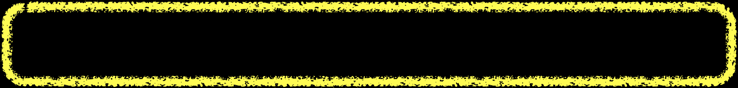
ADT Bag toVector Implementations
ArrayBag
LinkedBag
public T[] toArray()
{
@SuppressWarnings("unchecked")
T[] result = (T[])new Object[capacity]; // unchecked
for (int index = 0 ; index < numberOfEntries ; index++)
{
result[index] = bag[index];
} // end for
return result;
} // end toArray
public T[] toArray()
{
@SuppressWarnings("unchecked")
T[] result = (T[])new Object[numberOfEntries];
Node<T> currentNode = firstNode;
int index = 0;
while ((index < numberOfEntries)
&& (currentNode != null))
{
result[index] = currentNode.getData();
currentNode = currentNode.getNextNode();
index++;
} // end while
return result;
} // end toArray
O(n)
O(n)
Notes:
The ADT Bag toArray method implementations may appear similar to the contains method,
@@ but notice that the loops end ONLY once every item in the Bag has been copied in the array that is returned to the client.
This means that EVERY item in the Bag must be "touched" or copied every time this method executes. If our Bag contains n items - the loop executes n time -
@@ so our toArray method is big oh of n. This is also true of the "getFrequencyOf" method, since it also must touch or process EVERY item in the bag when counting the frequency of the target item.
We will see this was we examine the efficiency of other collections - if an algorithm must process or touch every entry in a collection, it will be big oh OF AT LEAST n.
You may have noticed that the LinkedBag while loop test has two termination conditions - both of these are in place so that the while loop correctly terminates after copying the last Bag entry, even though only one test is actually necessary.

Slide 24

Comparing Implementations
ADT Bag method | ArrayBag Implementation | LinkedBag Implementation
getCurrentSize() | O(1) | O(1)
isEmpty() | O(1) | O(1)
add(ItemType anEntry) | O(1) | O(1)
remove(ItemType anEntry) | O(1) to O(n) | O(1) to O(n)
clear() | O(1) | O(1) to O(n)
getFrequencyOf(ItemType anEntry) | O(n) | O(n)
contains(ItemType anEntry) | O(1) to O(n) | O(1) to O(n)
toVector() | O(n) | O(n)
ArrayBag
// O(1)
void ArrayBag::clear()
{
itemCount = 0;
} // end clear
LinkedBag
// O(n)
void LinkedBag::clear()
{
Node<ItemType>* deleteMe
= nullptr;
while (headPtr != nullptr)
{
deleteMe = headPtr;
headPtr = headPtr->getNext();
delete deleteMe;
itemCount--;
} // end while
} // end clear
Notes:
Using Big Oh notation,this table summarizes the time complexities of the operations of the ADT bag for the implementations that use a fixed-size array and a chain of linked nodes. For some operations, multiple time requirements indicate the best, worst, and average cases.
As you can see, all of the operations have the same Big Oh for both implementations with the exception of the clear() method. This similarity is unusual, but it reflects the simplicity of the ADT bag. Other ADTs, such as the ADT list, have at several operations whose time efficiencies differ significantly according to their implementations.
Let's look at the clear implementation a little closer.
@@ here is the ArrayBag clear method

Slide 25
Comparing Implementations
If the problem size is always small,
can probably ignore an algorithm’s efficiency
Weigh the trade-offs between an algorithm’s time requirements and its memory requirements
Notes:
When comparing several implementations of an ADT, if the problem size is always small, for example where n will always be less than 100, in most cases, we can ignore the algorithm's efficiency.
But as the number of entries in a collection grows, efficiency becomes critical. It is a good idea to test ADT implementations with large data sets so see how an algorithms efficiency impacts real world use.
@@ As we will see in other lectures, such as those on sorting, there is often a trade-off between an algorithm's efficiency and it's memory requirements. Said another way, some algorithms that are very efficient with respect to time, require a significant amount of extra storage to manipulate the data set.
In other situations, algorithms that require no storage additional to the data set, may be very inefficient with respect to time.

